Slide 1
Dark matter detectors
Dark matter & the Universe, lecture 5 illustrative slides
Ed Daw

Slide 2
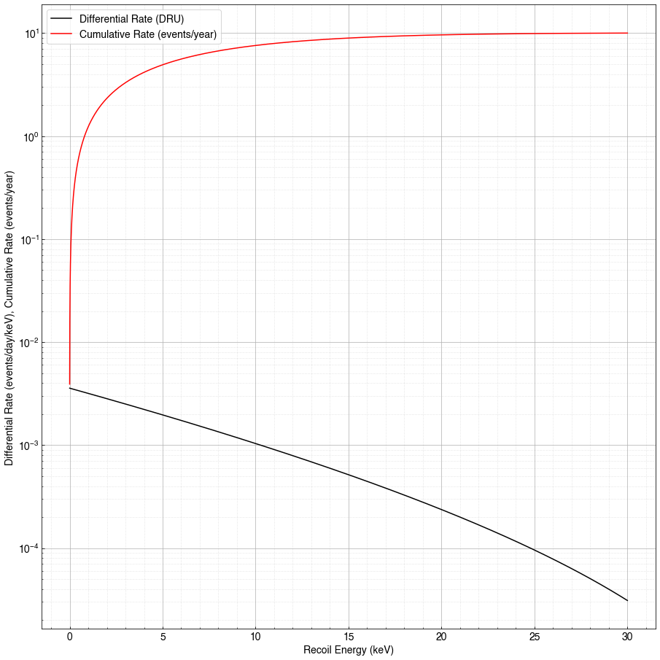
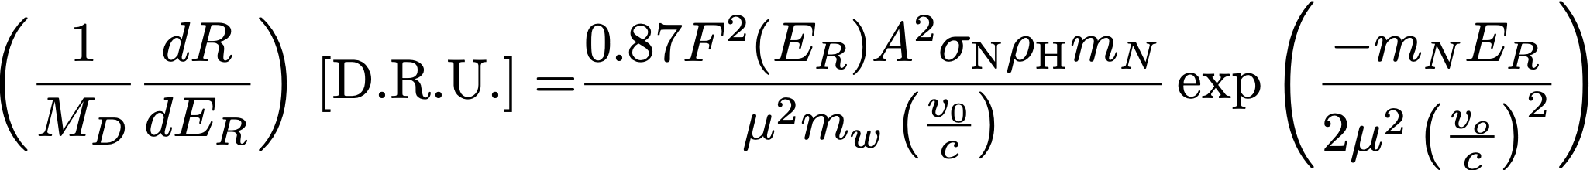
Differential WIMP scattering
rate
Total number of events in 1 year
assuming a 1000kg target and a
wimp nucleon cross section of
10⁻⁹ pb.
In lecture 4 we derived the differential rate for WIMP
nucleon elastic scattering. Per kg of detector,
The differential rate is plotted here assuming a 10⁻⁹ pb WIMP nucleon elastic scattering cross section, a 1000kg detector consisting of Xenon, A=131, and a 100GeV/c² wimp with a halo density of 0.45 GeV/c².
Also shown is the total rate up to 30keV recoil energy,
where the differential rate has dropped by two orders of magnitude. There are a total of 10 events, of which 5 are below a recoil energy of 5keV.
differential rate

Slide 3
from V.A. Kudryavtsev, Dark Matter and the Universe course notes, private communication (2025)

Slide 4
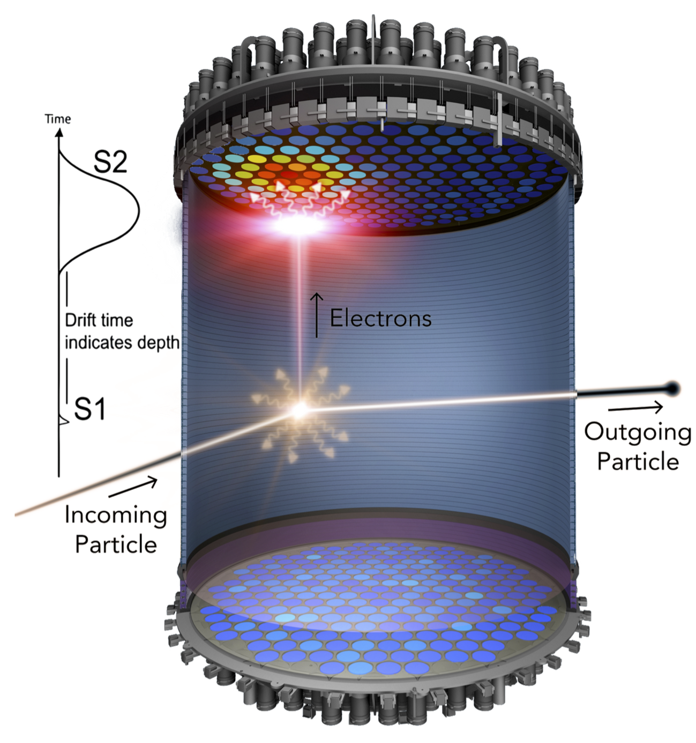
From the talk by Nicholas Fieldhouse,
DMUK meeting, 1st Dec 2025, Univ. of
Birmingham. https://indico.global/event/
15936/contributions/140215/attachments/
64983/125724/LZUpdates-NickF.pdf

Slide 5
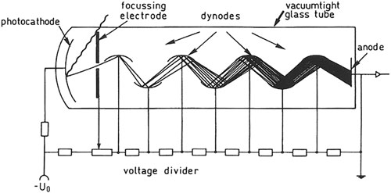
https://www.researchgate.net/publication/344039122/figure/fig18/AS:940738644811795@1601300979276/
Working-principle-of-a-photomultiplier-The-electrode-system-is-mounted-in-an-evacuated.ppm

Slide 6
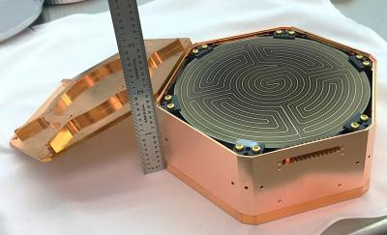
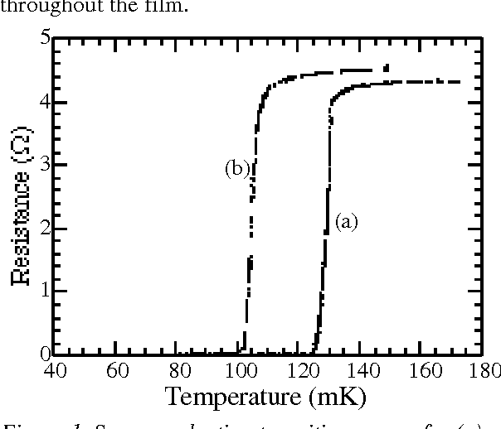
[1]
Bias the film with a constant voltage. The heating of the resistor is V²/R where R is the resistance.
When the temperature rises, the resistance rises, so the heating drops and the film cools again.
In this way, you can use a constant voltage to stabilize the film at a temperature part way up its
superconducting / normal conducting transition curve.
phonon signals manifest themselves as small pulses in the voltage caused by small energy
depositions giving rise to transient heating of the tungsten film.
[1] TUNING OF TUNGSTEN TRANSITION EDGE SENSORS USING IRON IMPLANTATION
https://api.semanticscholar.org/CorpusID:18675720

Slide 7
Sources of background
Dominated by radiation entering the cavity.
Neutrons and gamma rays are the most problematic
Cosmic rays can act as a source of neutrons
The detector itself can contain radioactive nuclides
The environment surrounding the detector.
In underground labs, radon is a particular issue.

Slide 8
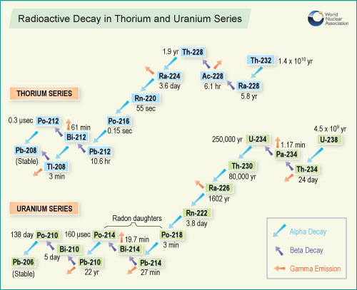
Backgrounds: radioactivity
Uranium and thorium decay chains.
⁴⁰K is present in natural potassium.
⁶⁰Co and other radioisotopes produced by cosmic rays at the surface and in other nuclear reactions (nuclear power plants, accidents, nuclear explosions).
from V.A. Kudryavtsev, Dark Matter and the Universe course notes, private communication (2025)

Slide 9
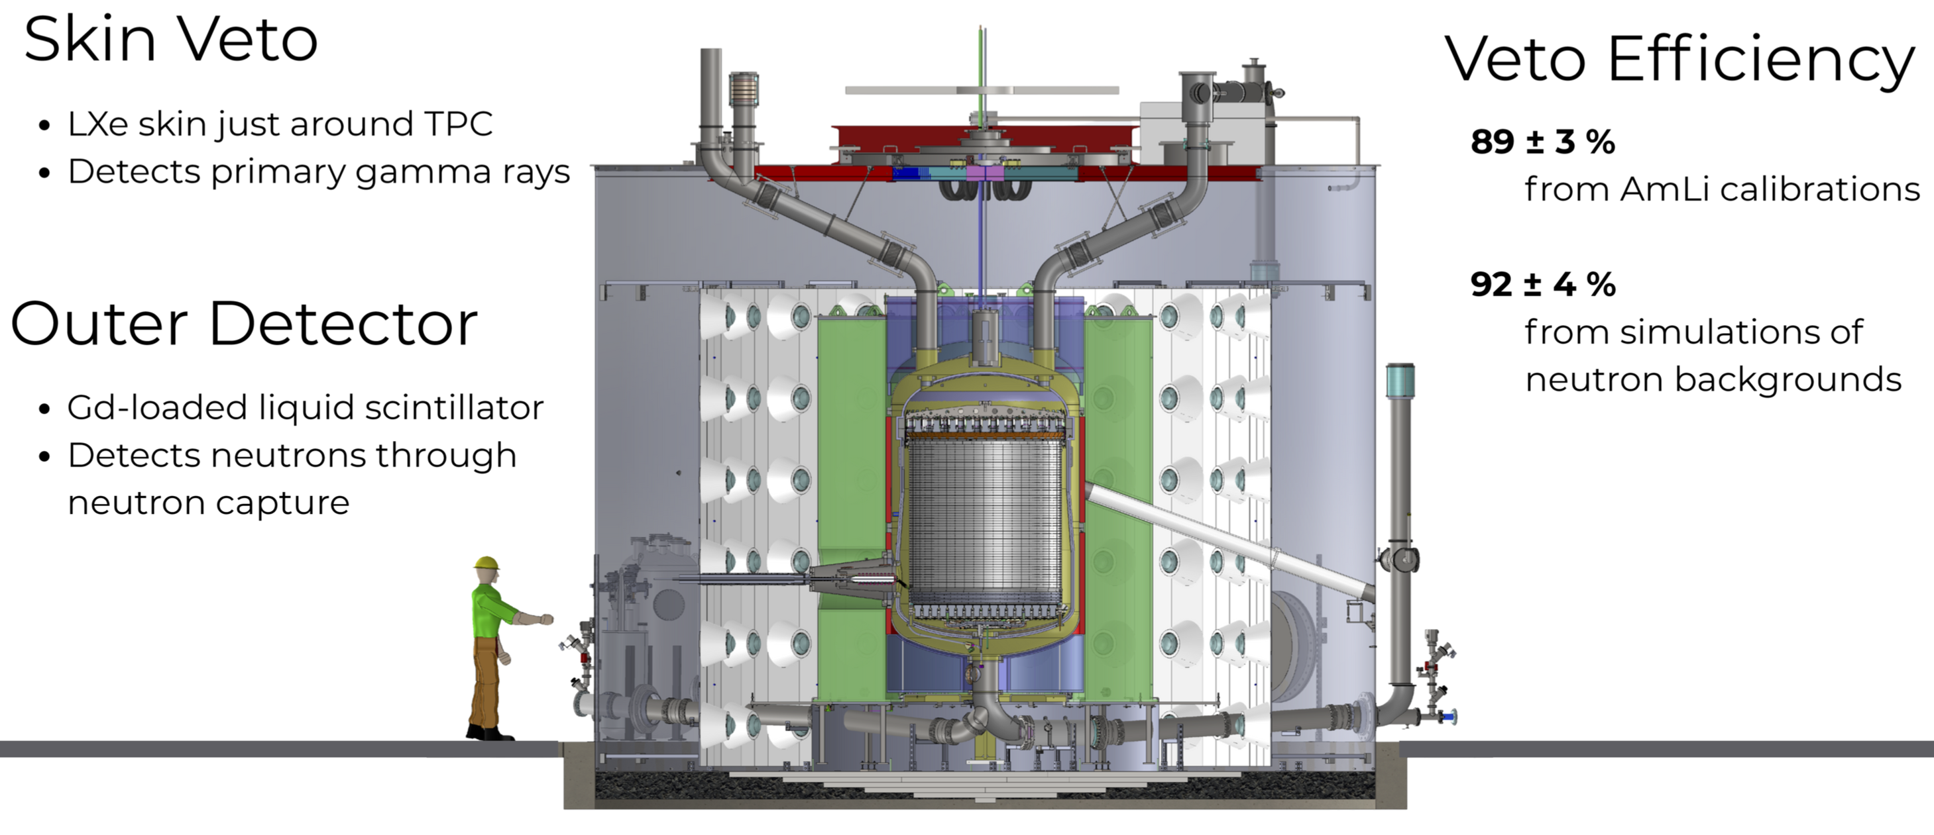
From the talk by Nicholas Fieldhouse,
DMUK meeting, 1st Dec 2025, Univ. of
Birmingham. https://indico.global/event/
15936/contributions/140215/attachments/
64983/125724/LZUpdates-NickF.pdf

Slide 10
From the talk by Nicholas Fieldhouse,
DMUK meeting, 1st Dec 2025, Univ. of
Birmingham. https://indico.global/event/
15936/contributions/140215/attachments/
64983/125724/LZUpdates-NickF.pdf

Slide 11
From the talk by Nicholas Fieldhouse,
DMUK meeting, 1st Dec 2025, Univ. of
Birmingham. https://indico.global/event/
15936/contributions/140215/attachments/
64983/125724/LZUpdates-NickF.pdf

Slide 12
Summary
Nuclear recoils carry keV of kinetic energy into a detector.
This energy can be converted into observable signatures – in particular scintillation light, ionization electrons and phonons (heating of the crystal)
Radioactive background can mask and mimic signals.
Underground operation is necessary to suppress cosmic rays.
The detector itself and the surrounding environment are also radioactive to some extent.
Shielding and vetoes are additional defences to suppress noise.
The detector can be fiducialised to eliminate events occurring near its surface.
Modern detectors have excluded WIMPs in our local halo with exquisite sensitivity, current limits are at the 2x10⁻¹² pb level!

